Slide 1

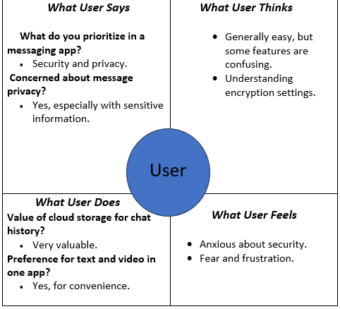
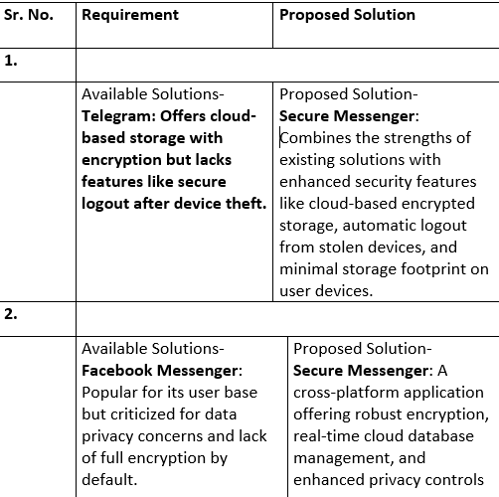
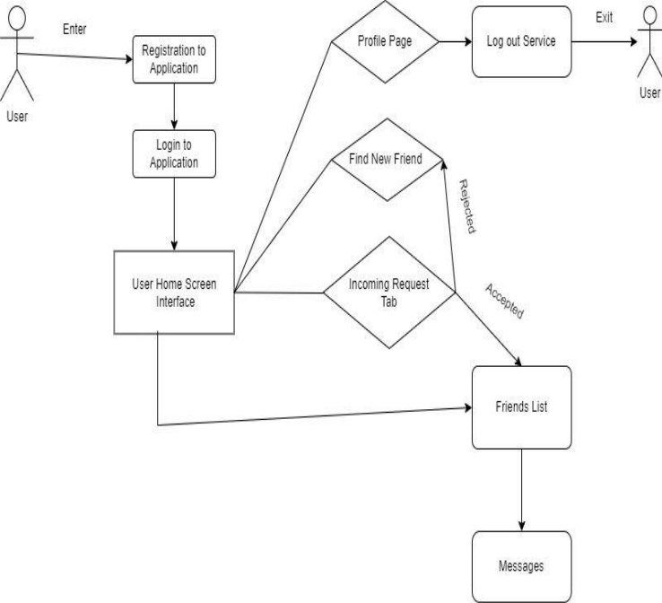
Proposed Architecture/ Diagram:
MIT SCHOOL OF COMPUTING
Class : TY DA
Group Id:
DEPARTMENT OF INFORMATION TECHNOLOGY
SECURE MESSENGER
AI based methodology to predict emotion using facial expressions
OMKAR RASAL,TANVI BODKE,AJINKYA SATHE, PRATHAMESH PANCHMIRE
Faculty Guide:
Prof. Ishwari Raskar
Problem statement
In today’s increasing technology there are several applications which provides a digital platform for communication but didn’t provide the security for our data as well as for our personal details.
Proposed Solution
develop a Secure Messenger application that ensures the security of communication by using high-level encryption and decryption. The application will allow users to communicate over a cloud environment securely, addressing the issues of data security, storage consumption, and unauthorized access.
Scope and Feasibility project aims to provide a secure, cloud-based communication platform using encryption to protect user data .The app has potential for growth with future features like video calls and file sharing, addressing a strong market demand for secure communication.

